Slide 1
Magnetic Force On A Current
By Aayan Ali Zaidi

Slide 2
Common Terms Used In This Topic:
Magnetic Force: Magnetic force is the force that arises from the interaction between magnetic fields and moving charges or changing electric fields.
Induced Current: Induced current is the current generated in a conductor when it is exposed to a changing magnetic field.
Magnetic Field: A magnetic field is a region around a magnet or current-carrying wire where magnetic forces can be detected.

Slide 3
Magnetic Force on a Current-Carrying Conductor
When a current-carrying wire is placed in a magnetic field, it experiences a push or pull. This is called the magnetic force on a current.
Electricity and magnetism are closely connected. When electric current flows through a wire, it creates a magnetic field around it. If that wire is placed inside another magnetic field, the two fields interact and produce a force on the wire. This force is known as the magnetic force on a current-carrying conductor, and it forms the working principle of electric motors.

Slide 4
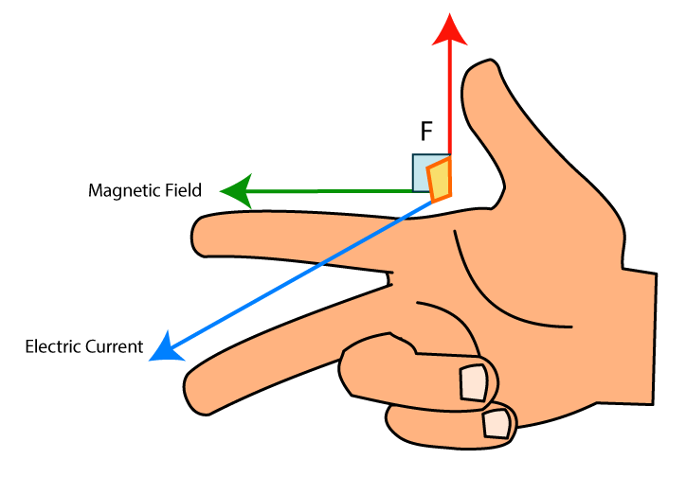
Right-Hand Rule:
Use your right hand to find direction:
Fingers → Current (I)
Palm → Magnetic field (B)
Thumb → Force (F)
Force is always perpendicular to both current and field.

Slide 5
The Formula:
F = B × I × L × sin(θ)
F = Force (Newton)
B = Magnetic field (Tesla)
I = Current (Amperes)
L = Length of conductor (meters)
θ = Angle between current and field
Maximum force at 90°, minimum force at 0°.

Slide 6
Applications:
Electric Motors: Used in fans, washing machines, and electric vehicles.
Generators: Convert mechanical energy into electrical energy using magnetic force.
Loudspeakers: Use the magnetic force to move the speaker cone and produce sound.
Magnetic Lifting Devices: Used in industries to lift heavy magnetic materials.
Maglev Trains: Use strong magnetic forces for propulsion.

Slide 7
Conclusion
Whenever a current flows through a magnetic field, the conductor experiences a magnetic force.
This force acts perpendicular to both the direction of the current and the magnetic field, as explained by the Right-Hand Rule.
This principle is the foundation of electric motors, generators, and many modern technologies.

